Slide 1



Git and GitHub
Professor Matthew Lanham
(Former) Academic Director, MS BAIM Program
Associate Director of Student Engagements,
Krenicki Center for Business Analytics & Machine Learning
MatthewALanham.com

Slide 2
Take-Aways
What is Git and GitHub?
The command line interface
Examples

Slide 3
Git is a version control system
What is Git?
Git is a popular open-source version control system that keeps track of changes to file(s) so you can recall older file changes later if needed.
It is free and open source and designed to handle varying sized projects quickly and efficiently (git-scm.com).
Many use git to: track files, combine different versions of files, identify a particular version, revert changes
Why is version control important?
Version control is regularly used in software development because a system is constantly being modified and saved by multiple collaborators, thus provides a means to manage the development process efficiently and reliably (Wikipedia).
Other popular version control systems you might see in practice
Subversion
Mercurial
Bitbucket (web-based service for Git)

Slide 4

Command Line Interface Pros/Cons
Pros
Windows users can use a program called Git Bash, which is shell or terminal that provides a direct command line environment for working with Git
Mac users may use Xcode Command Line Tools, Homebrew, or MacPorts as popular options
Cons
Operated from the command line

Slide 5
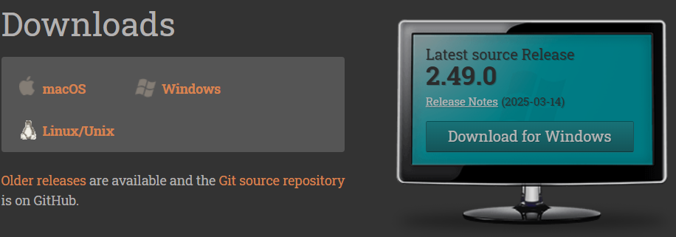
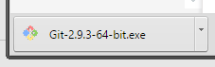
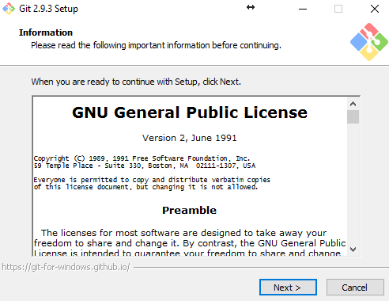
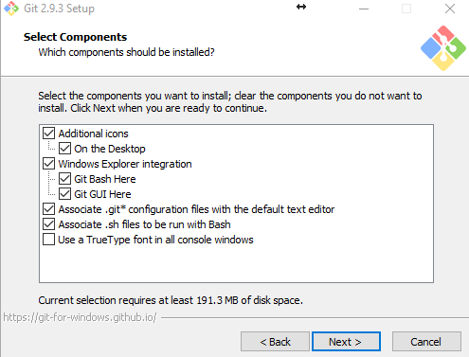
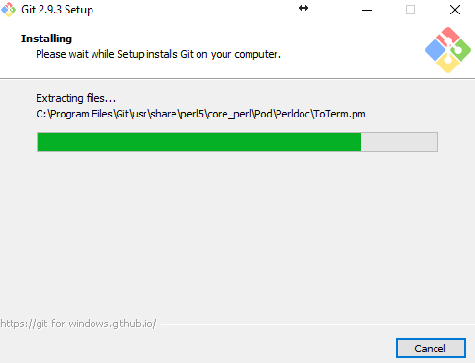
Setup Instructions
Go to https://git-scm.com/downloads
Download the version for your operating system
Install it (just use recommended defaults)
….

Slide 6
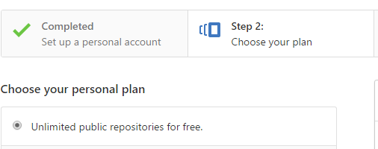
Configure GitHub
Whenever you save something to Git (e.g. homework assignment), you can “push” that work to the web on GitHub.
Go to GitHub (https://github.com/education/students)
Sign up using the same Purdue email address you used when setting up Git
Choose the free plan

Slide 7
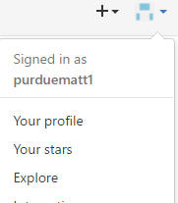
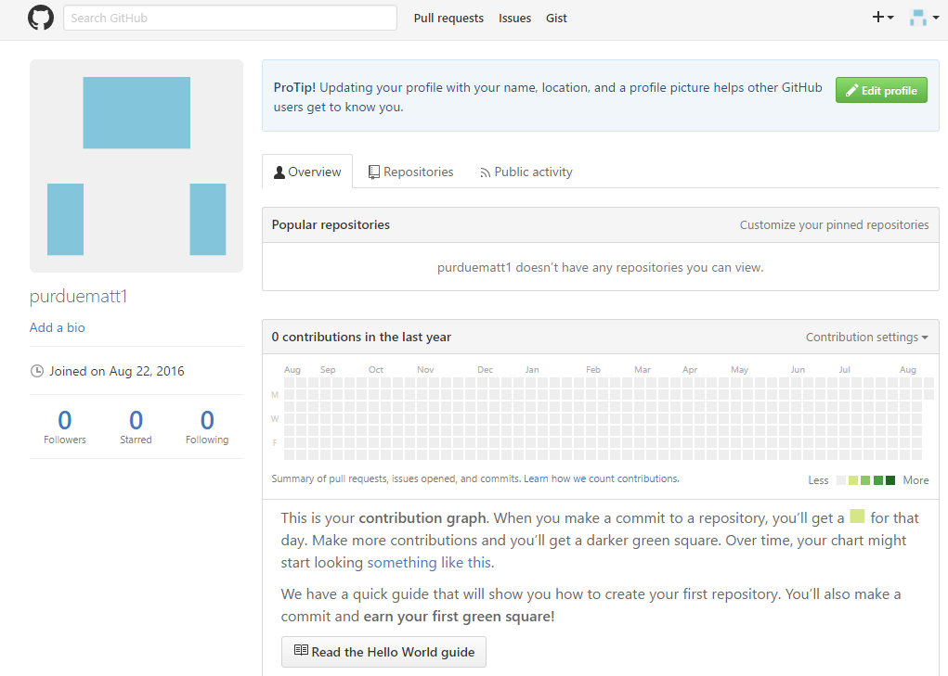
Configure GitHub
If you click the drop-down menu, and select “Your profile” you should have a page that looks something like this..

Slide 8

GitHub for Education
Since you are students you qualify to get GitHub for Education for free.
https://github.com/education/students
What is the difference between GitHub for Education and regular GitHub?
Nothing. You will just have additional functionality using GitHub for Education that costs money for those that do not qualify for the Education discount (e.g. private repos).
Follow the instructions on the next slide to set up your account

Slide 9
Command Line Interface (CLI)
Examples:
Create and edit files
Create and edit folders
Navigate folders
Run programs

Slide 10
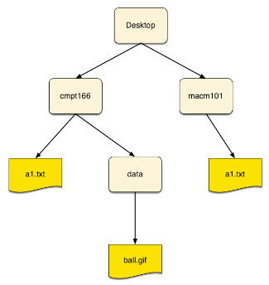
Directories & Hierarchies
Examples:
Create and edit files
Create and edit folders
Navigate folders
Run programs
a1.txt file contained inside the cmpt166 folder
Source: http://www.cs.sfu.ca/CourseCentral/166/tjd/_images/sampleFileSystem.png

Slide 11
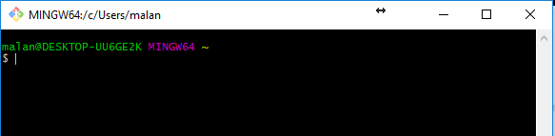
Start Git Bash
Git Bash should be in your applications under Git. Open Git Bash
Should look something like this with your computer name
The dollar sign means you can type a command if you want

Slide 12
Command line commands
The general structure is: command flags arguments
command
Does a certain task (e.g. ls would list the files in your current directory)
flags
Preceded by –
Options for the command to do particular behaviors
Flags can be combined such as -al
arguments
can be what the command is going to modify (or) other options for command
Some commands do not require flags or arguments

Slide 13
Examples
pwd shows you the path to the directory you are in now (i.e. your working directory). pwd stands for “print working directory.”
clear will clear out all the commands shown in your current CLI window
ls lists files and folders in the current directory
ls –a lists hidden and unhidden files and folders
items beginning with a dot “.” mean they are hidden
ls –al lists details for hidden and unhidden files and folders
git –-version will tell you which version of git you are using

Slide 14
Change and make directories
cd stands for “change directory.”
Takes as an argument the directory you want to visit
Typing no argument takes you to the home directory
Ex 1: cd Documents
Ex 2: cd "/c/Users/Matthew A. Lanham/Documents"
cd .. changes the directory you are at up one level in the path hierarchy
mkdir stands for “make directory.”
Similar to right-clicking and creating a new folder in windows
Takes as an argument the name of the directory you are creating
Ex: mkdir testFolder
ls
touch creates an empty file
Ex: touch outputResultsHere.txt
Put the path in quotes if there are spaces like there are in my name.

Slide 15
Copy and remove things
cp stands for “copy” and takes two arguments
First argument is the file you want to copy
Second argument is the path where you want the file to be copied
Ex 1: cd “My Pictures”
cp ThorGraduation.jpg "/c/Users/Matthew A. Lanham/Desktop"
Can also be used to copy the contents of entire directories, but you need to use the –r flag
Ex: cp –r Screenshots copiedScreenshots
rm stands for “remove,” and takes the name of a file you wish to remove as its arguments
Ex: rm Screenshot.png
Using the –r flag, one can delete the contents of an entire directory. Caution!
Ex: rm –r copiedScreenshots

Slide 16
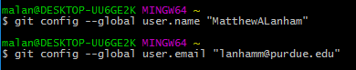
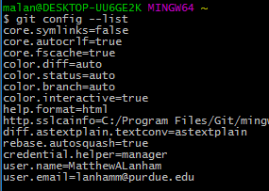
Configure Git
When you commit your work to a Git repo, it will be tagged with the username of the individual whom made the commit.
The first thing we need to do is set this up (you can change this later if you choose).
Type the following but replace “MatthewALanham” and “lanhamm@purdue” with your information. Also make sure to use your @purdue.edu email so you can get the GitHub for Education discount.
Now type the following to confirm these changes:
What is returned

Slide 17


Git to GitHub
Git stores your work on your computer
GitHub stores your work on the web so you can share and collaborate on it with others (choose wisely what to share)

Slide 18
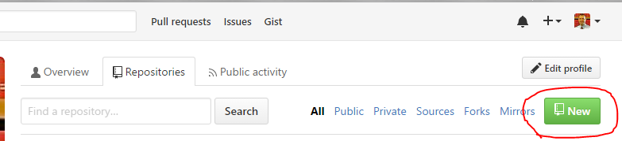
Creating a GitHub Repo
There are a couple ways to create a GitHub repo
Create a new repo on GitHub

Slide 19
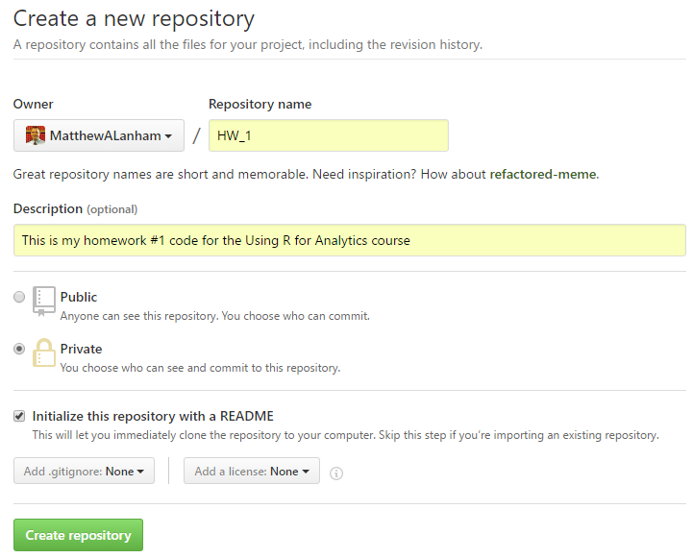
Creating a new repo on GitHub
Fill out the following: Give your repo a name, brief description, and choose Private, check box
Example:

Slide 20
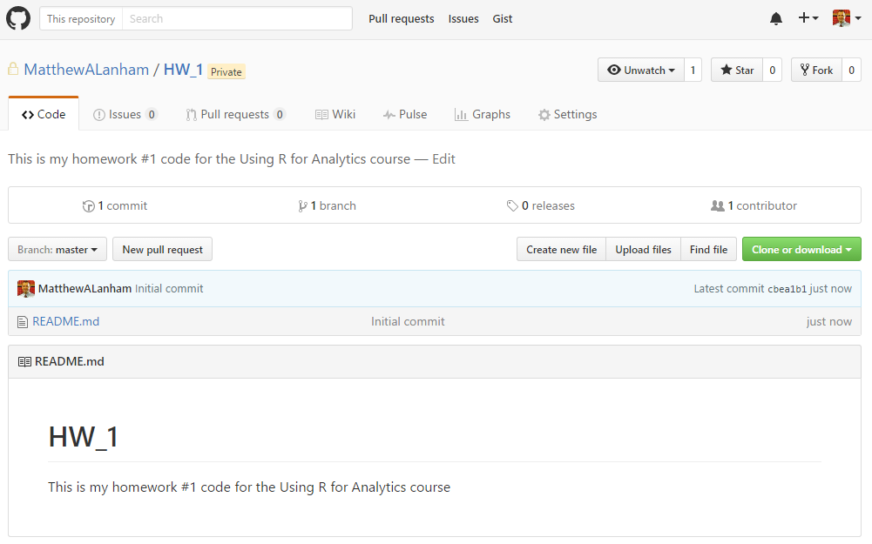
You have just created your first GitHub repo
It should look something like this…

Slide 21
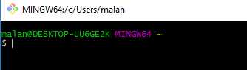
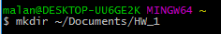
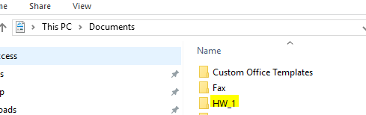
Now, you need to create a local copy of this
So you can make changes to this repo, you need to create a copy of it on your computer
Open Git Bash
Create a directory on your computer where you want to store your copy of this repo
Here I am making a folder called “HW_1” under Documents
If you want, you can verify that you created the folder by going to that directory as I show below just to prove it to yourself

Slide 22
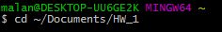
Now, you need to create a local copy of this
Continuing from the last slide
Now go to that folder you just created using the cd command
Initialize a local Git repo in this directory
Note: You’ll get something like “Initialized empty Git repository ….” This is okay.
Point your local repo at the remote repo on GitHub that you created
git remote add origin https://github.com/yourUserNameGoesHere/yourRepoName.git

Slide 23
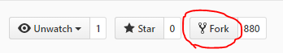
Forking a repo
If you do not create a repo from scratch, you can fork someone else’s work
Find the person’s work you want to fork, then click Fork – that easy
Example: Hadley Wickham is well known for ggplot2 R package as well as others. He wrote the book Advanced R in R ☺ and provided the code on GitHub. I forked this. How did I do it?
I went to to https://github.com/hadley/adv-r
Then just clicked Fork and now I have a copy of this in my repo on GitHub

Slide 24
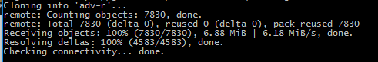
Clone a repo
After you fork a repo, you could clone it to your local machine if you like. You might not want to clone Hadley’s entire Advanced R book, but you could like so…
git clone https://github.com/yourUserName/repoName.git
If you did this, it would look something like this…
Maybe you do not plan on contributing, rather you would just like to modify his code for some of your own work

Slide 25
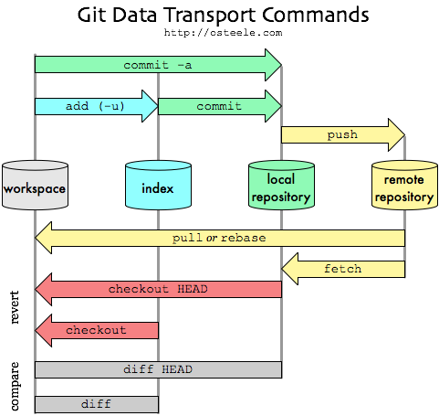
Pushing and pulling code

Slide 26
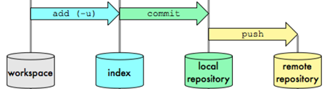
Adding, Committing, and Pushing stuff
Step 1: Add stuff
When are you are ready to add stuff to your local repo, you must tell Git that you want the file(s) to be tracked, so do one of the following:
git add .
Adds all new files
git add –u
Will update tracking for files that changed names or you deleted
git add –A
performs both of the above
You should do this before committing your work. If you do not tell git that you wanted the files to be tracked it wont understand what to commit.
Step 2: Commit stuff
Use the following command to commit changes to Git on your machine:
git commit –m “whatever message you want to provide to say what changed”
Step 3: Push stuff to GitHub
git push
git push –u origin master
(if it makes you specify a branch)

Slide 27
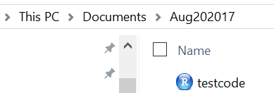
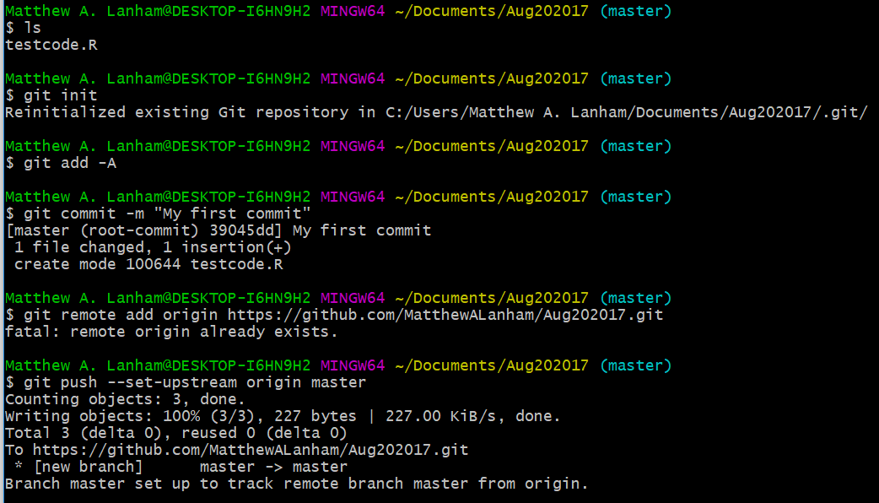
Example
Say I wrote some R code and save my testCode.R script in that folder.

Slide 28
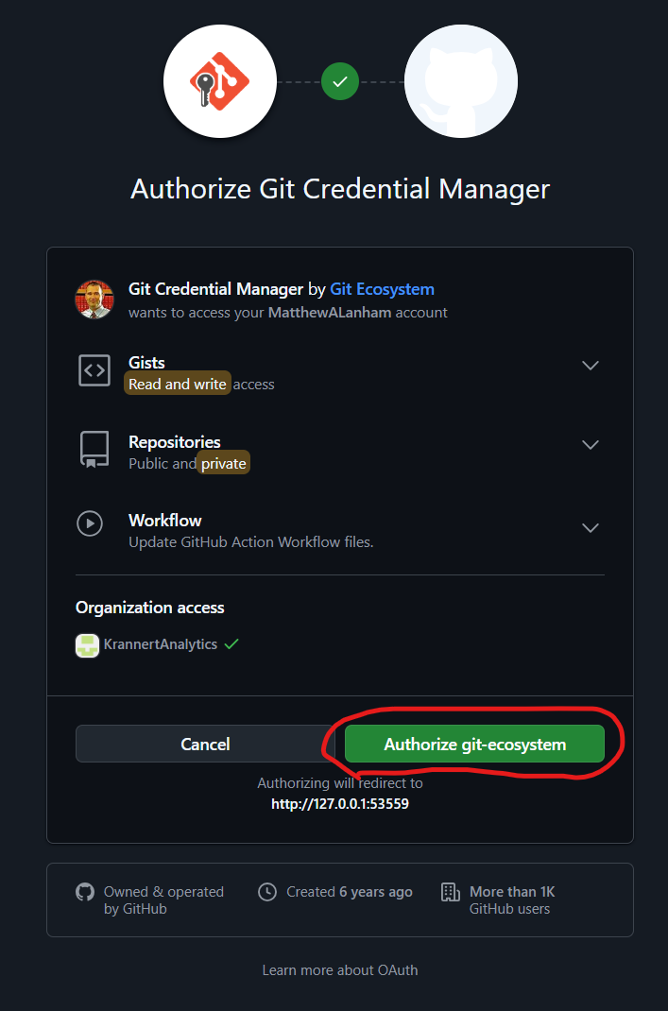
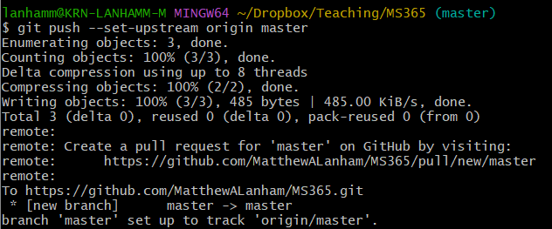
Example
You will probably get something like this. Just Authorize

Slide 29

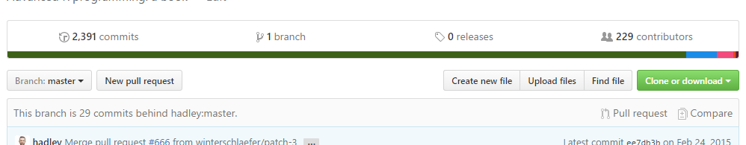
Pull requests
If you are working on a branch or fork of another repo, you can merge in the changes if you like into another repo (or branch). To do this on GitHub, you’ll just send a pull request.
Step 1: Select branch
Step 2: New pull request

Slide 30
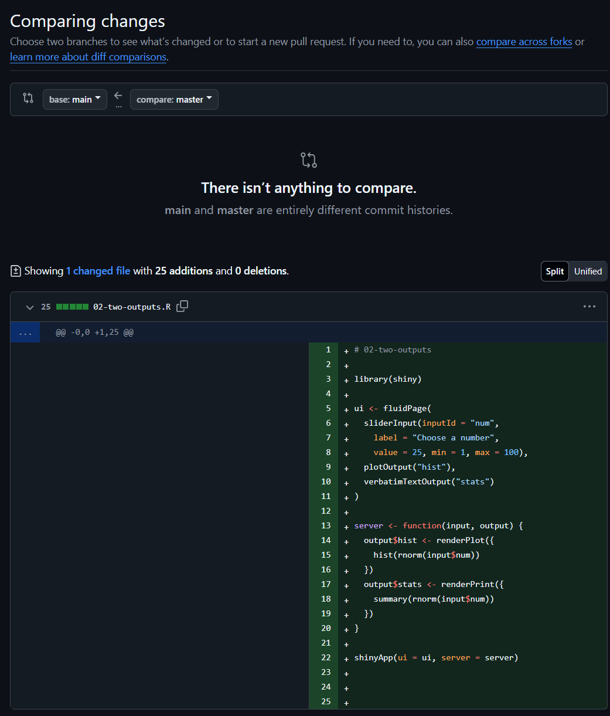
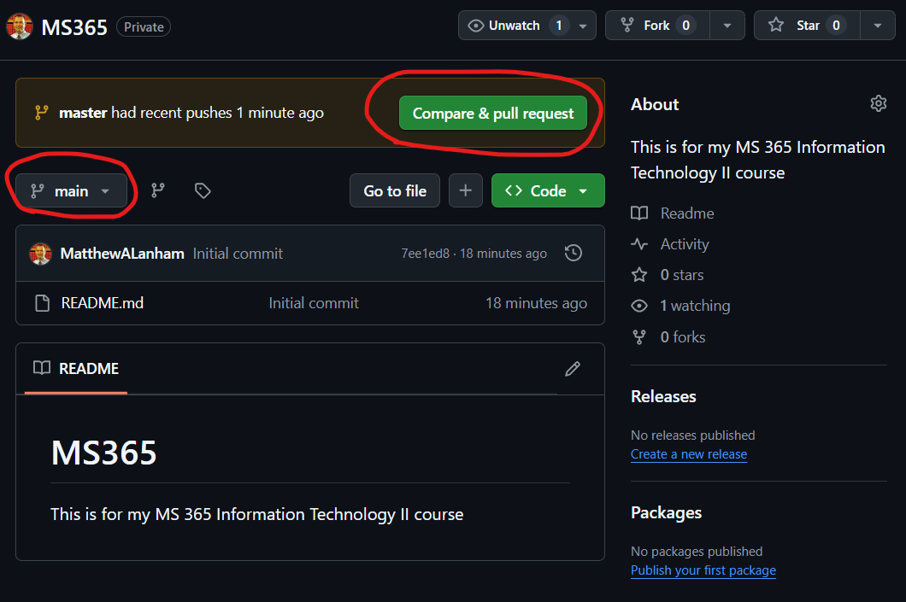
Pull requests
Here I click Compare & pull request. Here you can compare the code(s) to review differences and decide to accept them or not.

Slide 31

Creating Branches
Branches are used when you are working on a project with a version used by many people and you do not want to edit the version. A branch is basically another version of the same directory that you can make changes independently
To Create a branch:
git checkout –b branchname
To see what branch you are on:
git branch
To switch back to the master branch (which is the default):
git checkout master

Slide 32
Final thoughts
Git is the most popular versioning control used today and GitHub is helping change the way people share and collaborate technical knowledge.
Knowing just a few commands can help you back up and share your work with others. Some of you may end up doing much coding either in R or some other language that requires change control, and you will end up learning much more than what is covered here.
The rest of you should definitely be aware of its purpose and be able to perform basic operations such as add, commit, and push.
In class lab
Install git
Create a GitHub education account
Create a private repo on your GitHub account
Connect a folder on your laptop to that private GitHub repo
Push some files to your GitHub repo

Slide 33
The Git Workflow – Common Commands
Avoid NESTED REPOs - creating a Git repo inside another Git repo
This will make .git directories and make git confused on which one to update
Initiative a git repo using git init NAME
The Git Workflow
Staging versus committing
Adding a file to a staging area by using git add NAME
If you want to add all modified files use git add . where the “dot” means all files
Use git commit –m “a comment of what you did” the –m lets you provide a message.
Use git status to check state of the file(s)
Viewing the version history
Git commits have three parts: Commit, Tree, and Blob
Commit contains metadata – author, log message, and commit time
Tree tracks the names and locations of files and directories in the repo (like a dictionary)
Blob is Binary Large Object which may contain data of any kind
git log shows what has been logged

Slide 34
The Git Workflow – Common Commands
Version history tips and tricks
git log -3 to show the three most recent commits
git log filename to show the commit history of just this file
git log -2 filename to show a files most recent two commits
git log --since=‘Apr 2 2024’ --until ‘Apr 20 2024’ to see commits between dates
git log --since=‘2024-12-24’ --until ‘2024-12-24’ to see commits between dates
git show 44b45g4 to find a particular hash without providing the full hash
Comparing versions
git diff shows difference between versions
git diff report.md compares last committed version with latest not in staging area
git add report.md adds report.md to the staging area
git diff --staged report.md compares last committed version of report.md with the version in the staging area
git diff --staged would compare all staged files to versions in the last commit
git log will help you find the commit hashes, then you can use them next.
git diff 33jf434 343jf34 compares two hashes. Put most recent hash second.
git diff HEAD~1 HEAD compares the second most recent with the most recent commit

Slide 35
The Git Workflow – Common Commands
Restoring and reverting files
git revert reinstates previous versions and makes a commit. Note that it restores all files updated in the given commit not a single file. Usually provide the hash you want or HEAD
git revert HEAD reverts to the most previous commit
Save: Ctrl + 0, then Enter
Exit: Ctrl + X
git revert --no-edit HEAD will avoid opening the text editor
git revert –n HEAD will revert without committing (bring files into the staging area). –n is short for no commit.
git checkout allows you to revert a single file.
git checkout HEAD~1 -- report.md
git status allows you to check the checkout
git commit –m “Checkout previous version of report.md” would then allow you to commit.
git restore --staged summary_statistics.csv allows you to unstage a single file.
git restore --staged will unstage all files.

Slide 36
Intro to Branches
Branches
A Branch is an individual version of a repo
Git uses branches to systematically track multiple versions of files
In each branch:
Some files might be the same
Others might be different
Some may not exist at all
Branches are essential for continuous software development
By default, every repo has a branch called ‘main’
You might use other branches for future feature development without impacting the currently working branch
Allows multiple developers to work on a project simultaneously
Can compare the state of a repo between branches
Can combine contents, pushing new features to a live system
Generally, each branch should have a specific purpose
Remotes
Conflicts

Slide 37
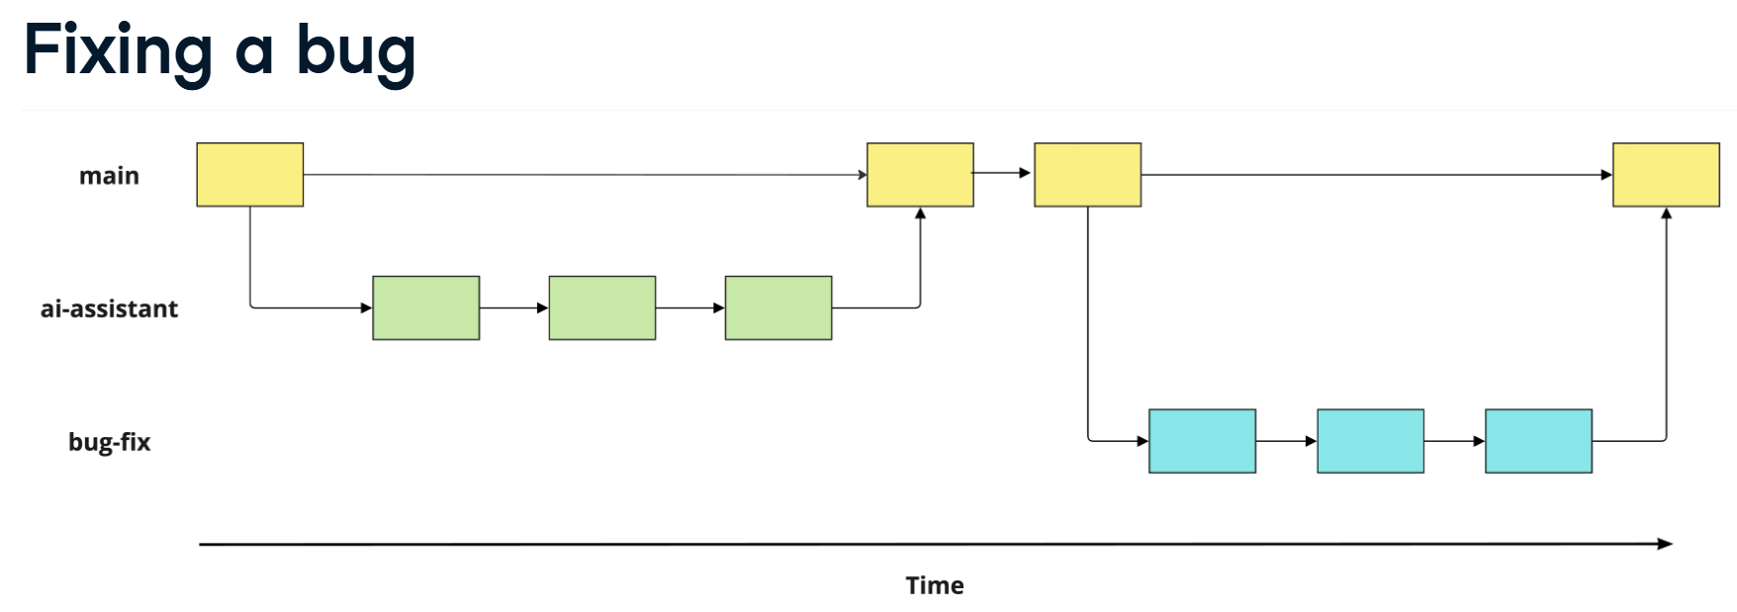
Intro to Branches
Generally, each branch should have a specific purpose

Slide 38
Intro to Branches
git branch lists all the branches
git switch main allows you to switch between branches. Here we switched to the ‘main’ branch.
git branch speed-test creates a new branch called speed-test
git switch speed-test would then switch us to the speed-test branch
git switch –c speed-test creates a new branch called speed-test and switches to it
When you create a new branch, people will refer to this as “branching off”. For example, creating a speed-test branch from the main branch, you’d say you are “branching off main.”

Slide 39
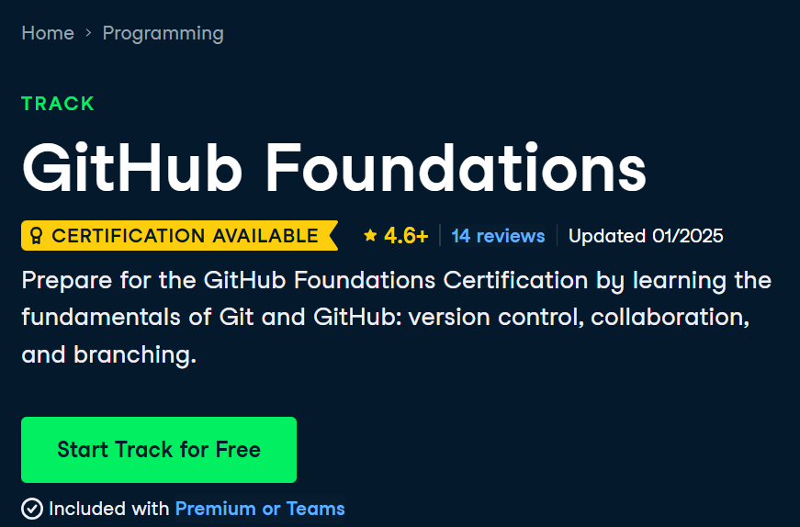
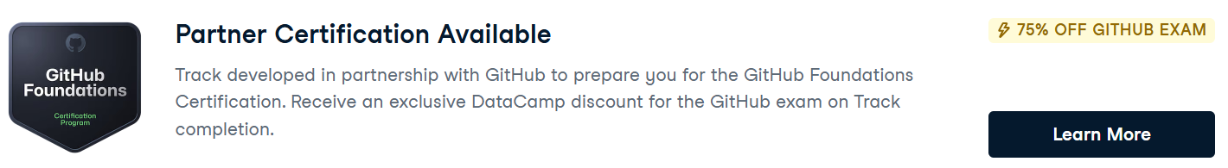
Modifying and Comparing Branches
git branch lists all the branches
git switch main allows you to switch between branches. Here we switched to the ‘main’ branch.
git branch speed-test creates a new branch called speed-test
git switch speed-test would then switch us to the speed-test branch
git switch –c speed-test creates a new branch called speed-test and switches to it
Check out this DataCamp GitHub Foundations skills track to learn more and get more practice.
https://www.datacamp.com/tracks/github-foundations

Slide 40
Creating a Portfolio Site on GitHub Pages to Showcase Your Work
Professor Matthew Lanham
(Former) Academic Director, MS BAIM Program
Associate Director of Student Engagements,
Krenicki Center for Business Analytics & Machine Learning
MatthewALanham.com

Slide 41
GitHub Pages
You can host a static website of your projects directly from your GitHub repo using GitHub Pages
Go to https://pages.github.com/
What is GitHub Pages?
Static site hosting service (i.e., no server-side rendering)
No application server
Front-end clients only
Can you front-end frameworks (e.g., angular, react) with compiled output or build step via GitHub Actions
You get one “main” site per Github account
https://github.com/github-username.github.io
Example: https://github.com/MatthewALanham/MatthewALanham.github.io
You get one site per GitHub account and organization, and unlimited project sites. I’d suggest you choose an organization site where you can highlight all your projects together as shown in red. Otherwise, you could have unlimited “project” sites like so:
https://github.com/github-username.github.io/project-name

Slide 42
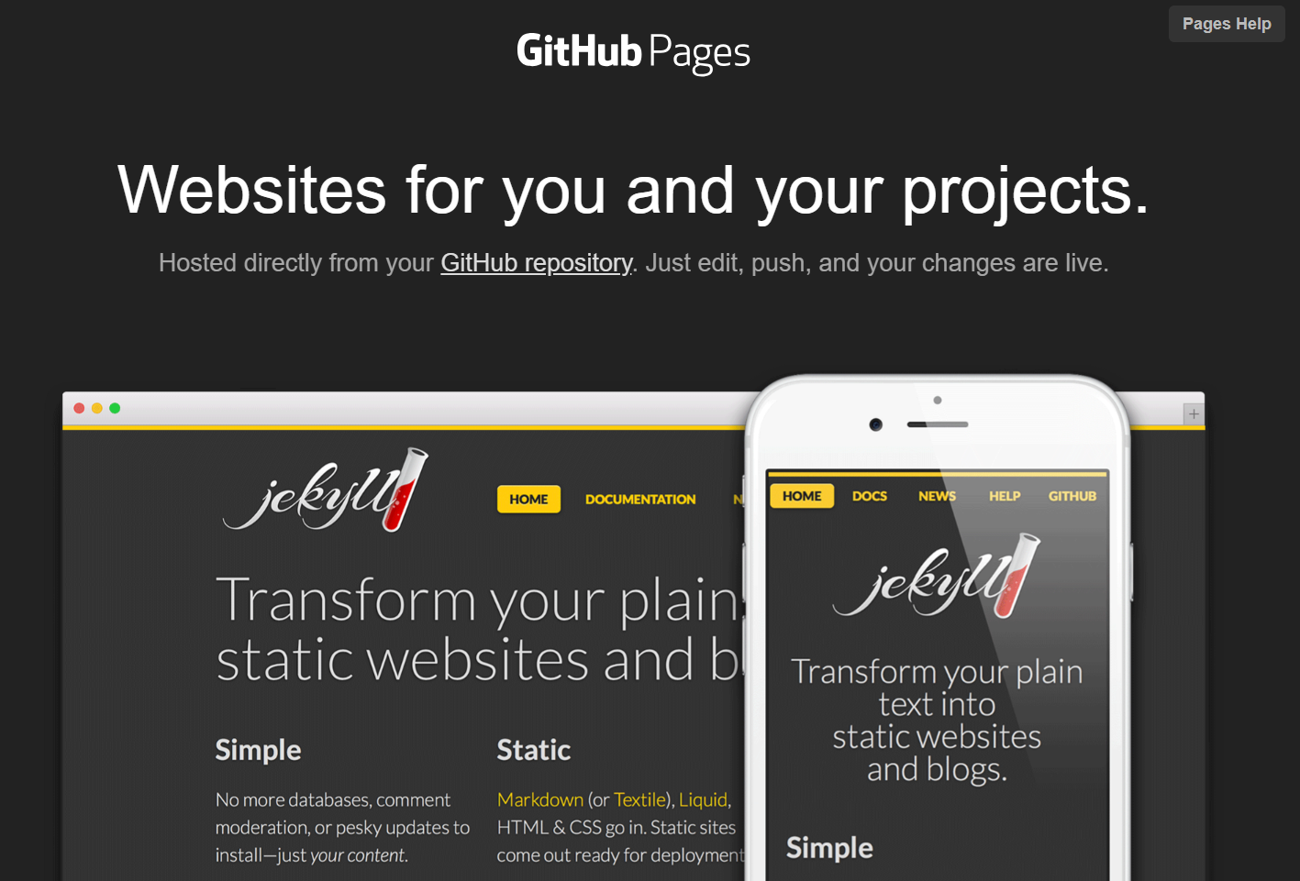
GitHub Pages
There are a couple different options to create a site using GitHub Pages:

Slide 43
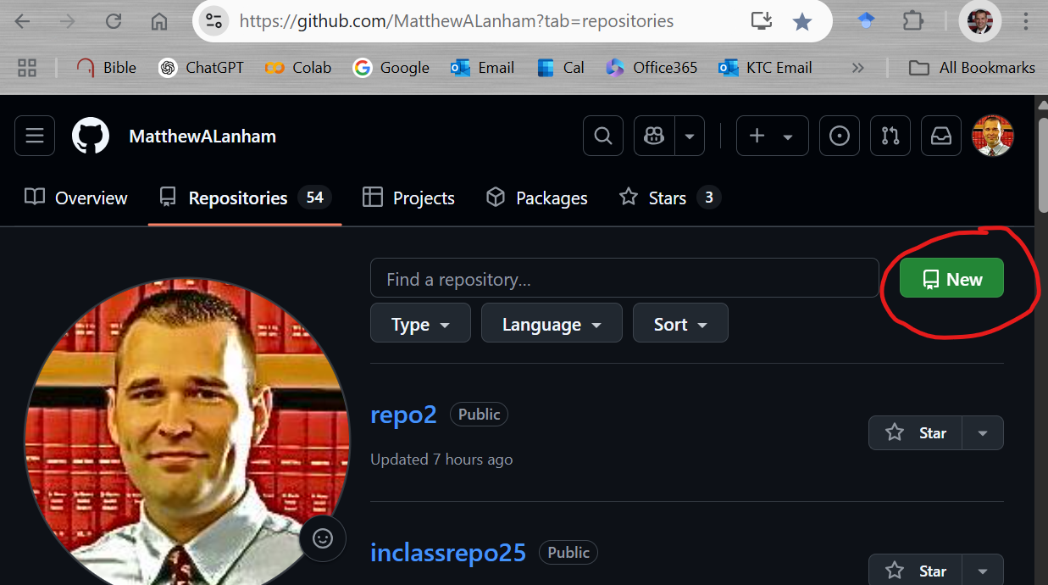
Step 1: Create a new public repo on your GitHub account
Go your GitHub site to the Repositories tab and click New to create a new Repo
MatthewALanham.github.io

Slide 44
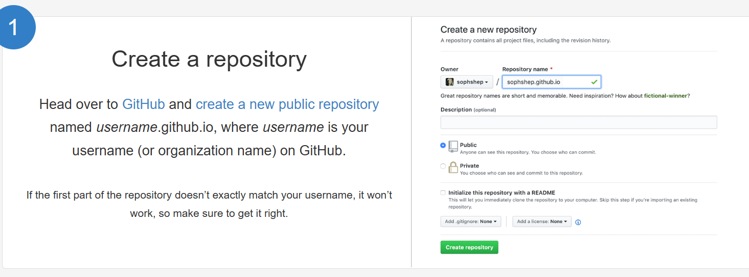
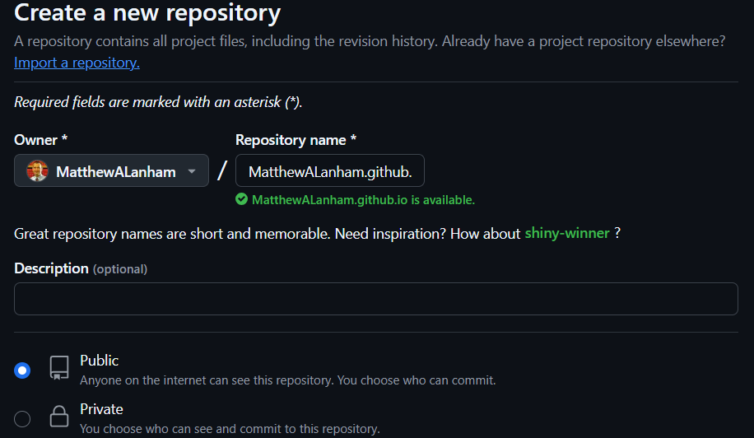
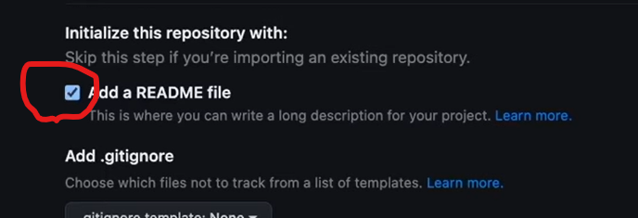
Step 1: username.github.io
Mine is MatthewALanham.github.io
Add README file

Slide 45
Step 1: username.github.io
Add a config file by going to add MatthewALanham.github.io

Slide 46
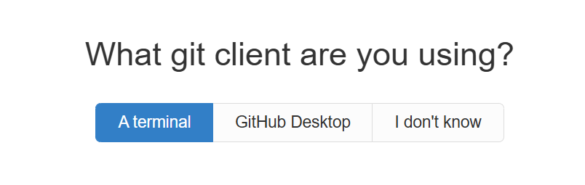

Step 2: Choose what git client you are using
You can always change this later. How about we try ‘A terminal’ so we can practice the git commands we learned?
GitHub Desktop is officially supported on Windows and macOS, but not on Linux. If you would like to explore using GitHub Desktop for your version control tool go here.
NOTE: What you pick here doesn’t matter much. I prefer VS Code as it allows you to track, commit, and push there without writing any commands.

Slide 47
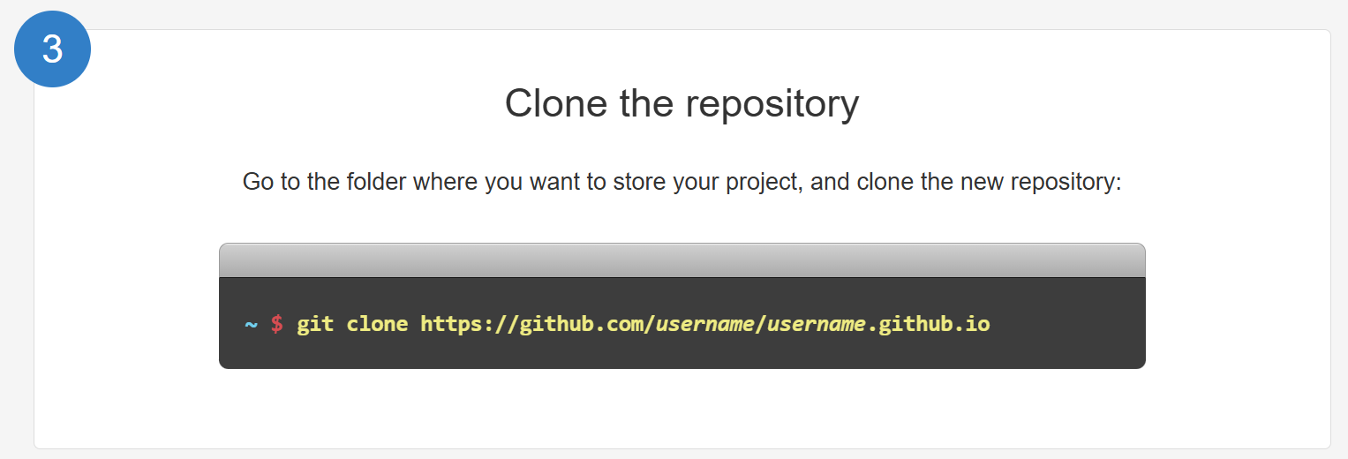
Step 3: Clone the repository
Again, here you only need to change username to your personal GitHub username

Slide 48
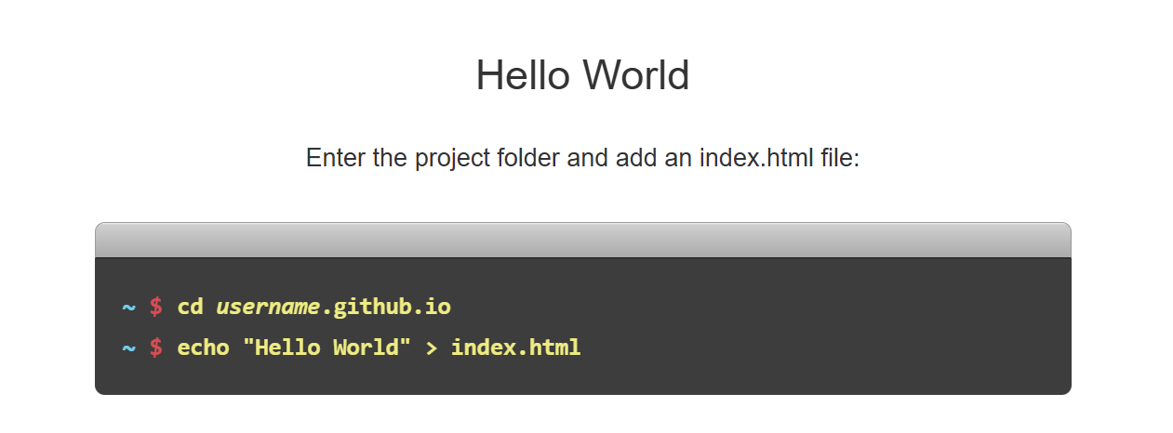
Step 4: Clone the repository
Again, here you only need to change username to your personal GitHub username

Slide 49
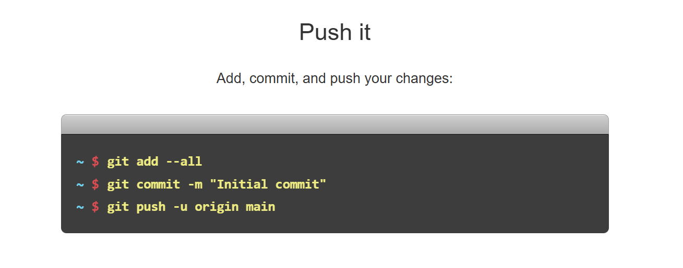
Step 5: Clone the repository
Use your git commands to push your project from your laptop to the cloud (GitHub)

Slide 50
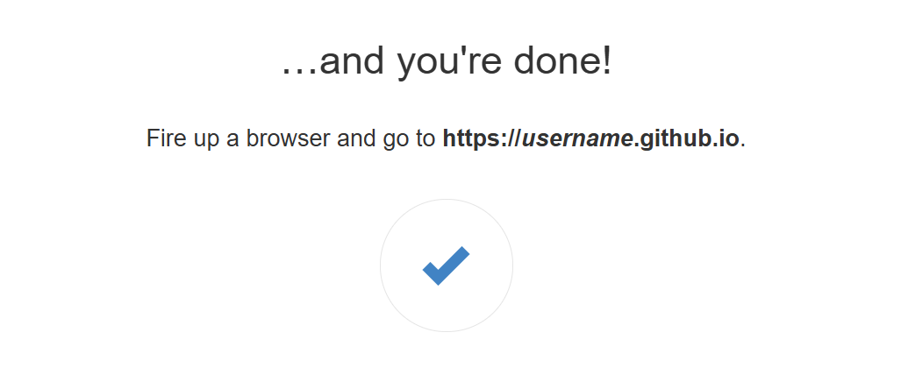
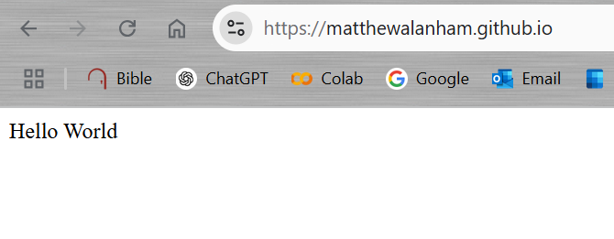
Step 6: Test it out
See if it works…
Mine is…

Slide 51
Recap
Basically, how it works every time you want to make changes.
# STEP 1: On Git Bash go to your location where you are storying the project files
cd "C:/Users/lanhamm/Dropbox/_mygithub/"
git clone https://github.com/MatthewALanham/MatthewALanham.github.io
cd MatthewALanham.github.io
#STEP 2: make any changes to the files locally
** could be anything **
** Here is an example where I changed the html - https://matthewalanham.github.io/*
# STEP 3: track, commit, then push our your changes to Github
git add --all
git commit -m "seeing what website looks like"
git push -u origin main
https://matthewalanham.github.io/

Slide 52
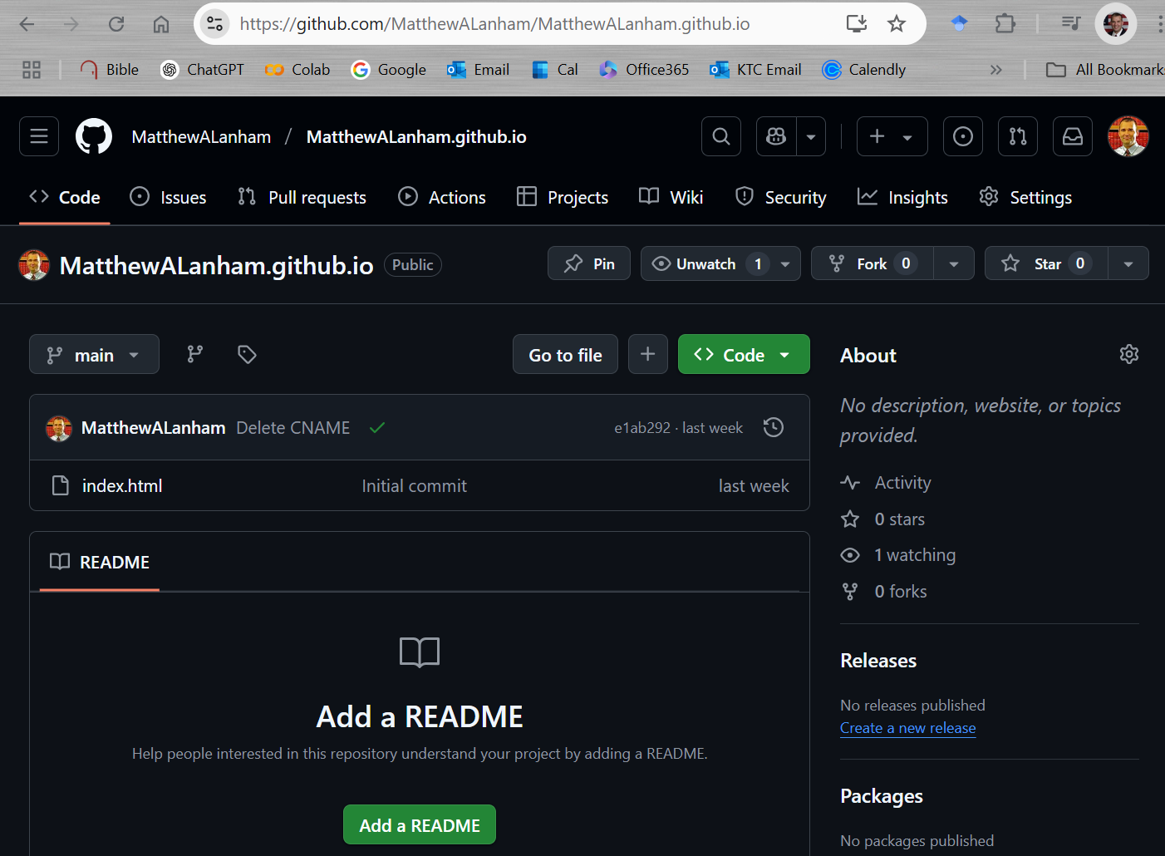
You will see your index.html file here…
Just change to your username….
https://github.com/MatthewALanham/MatthewALanham.github.io

Slide 53
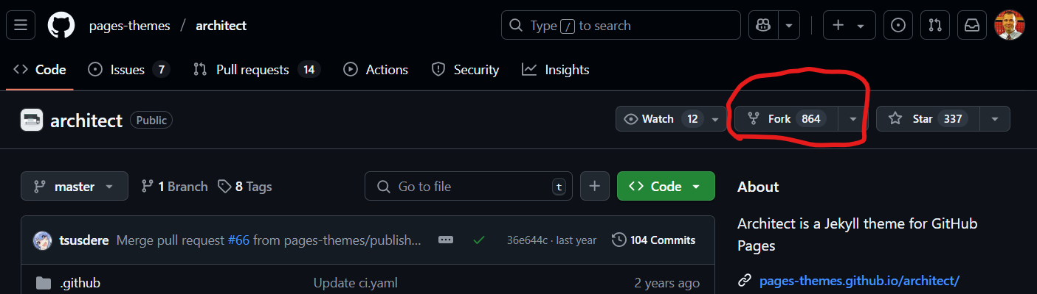
Using someone else’s theme template for your website
Instead of doing all the HTML and CSS coding yourself, you may just want to use someone else’s already created professional theme.
This is easy to do:
# STEP 1: Find the theme you like (see next slides that show popular supported options)
# STEP 2: Fork it (here is example of the “architect theme”). This will put a complete copy of all that site on your github account and you can change the HTML for your info and projects.
# STEP 3-5: Follow the “recap” steps shown two slides previously

Slide 54
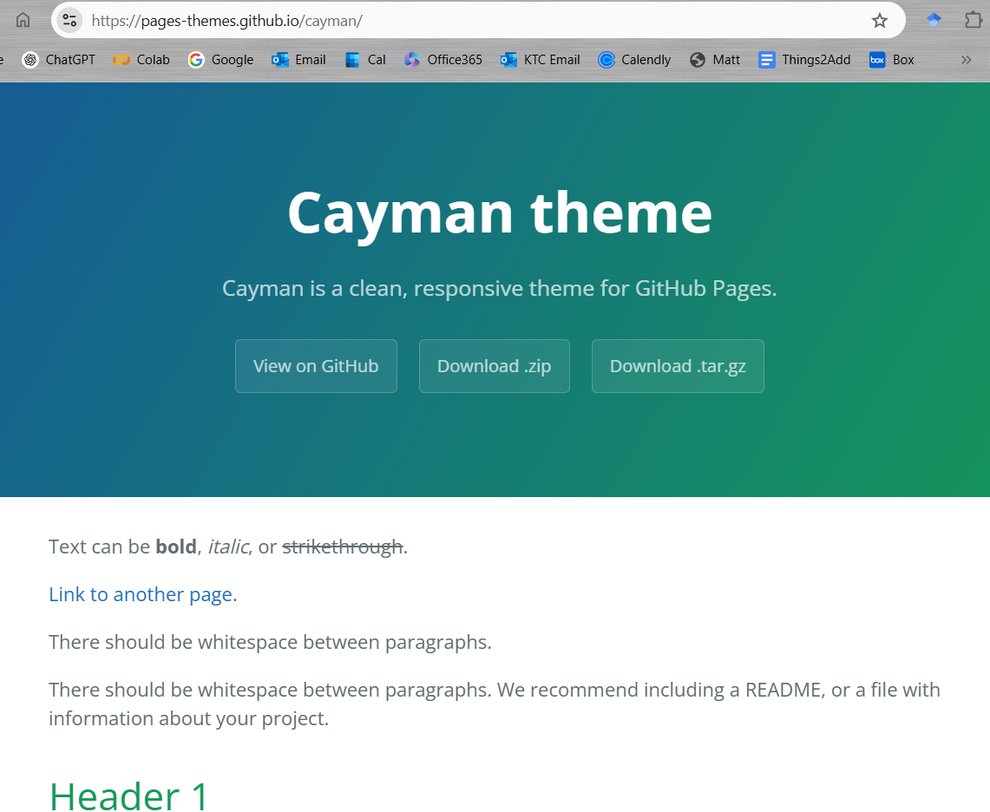
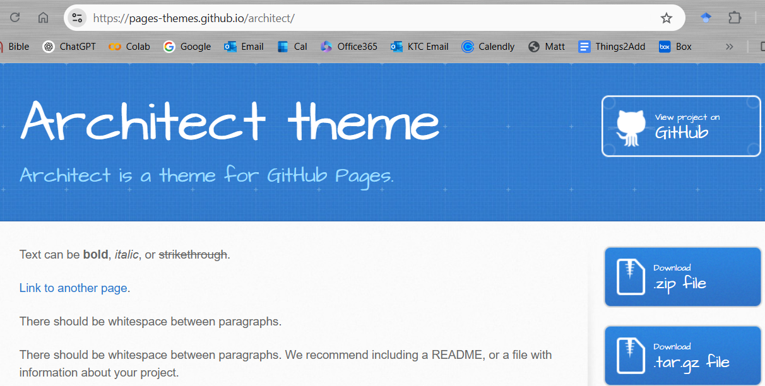
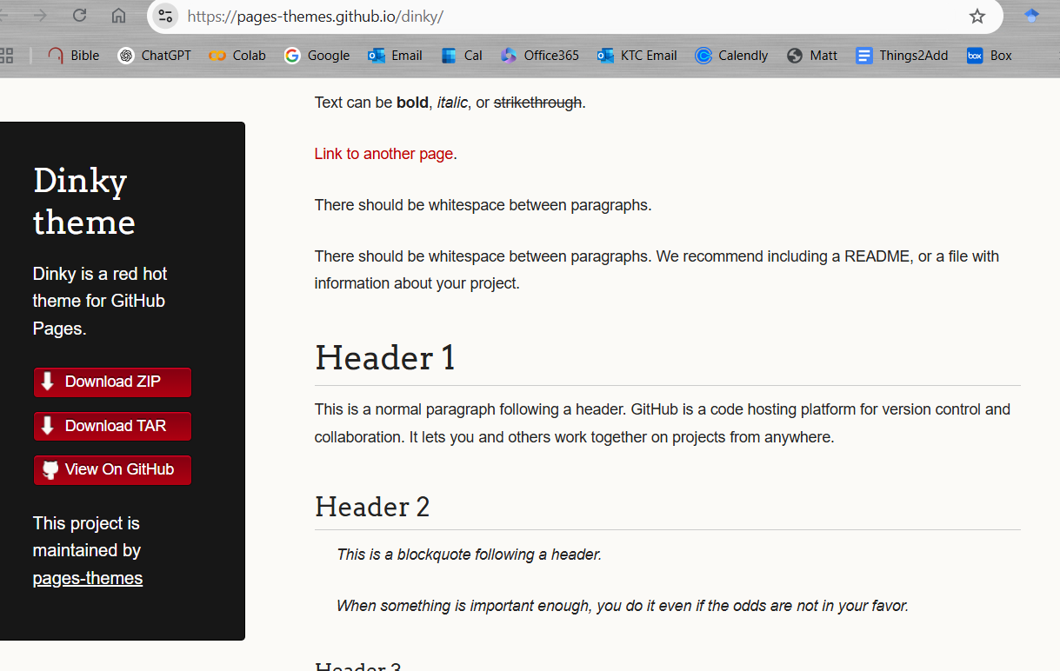
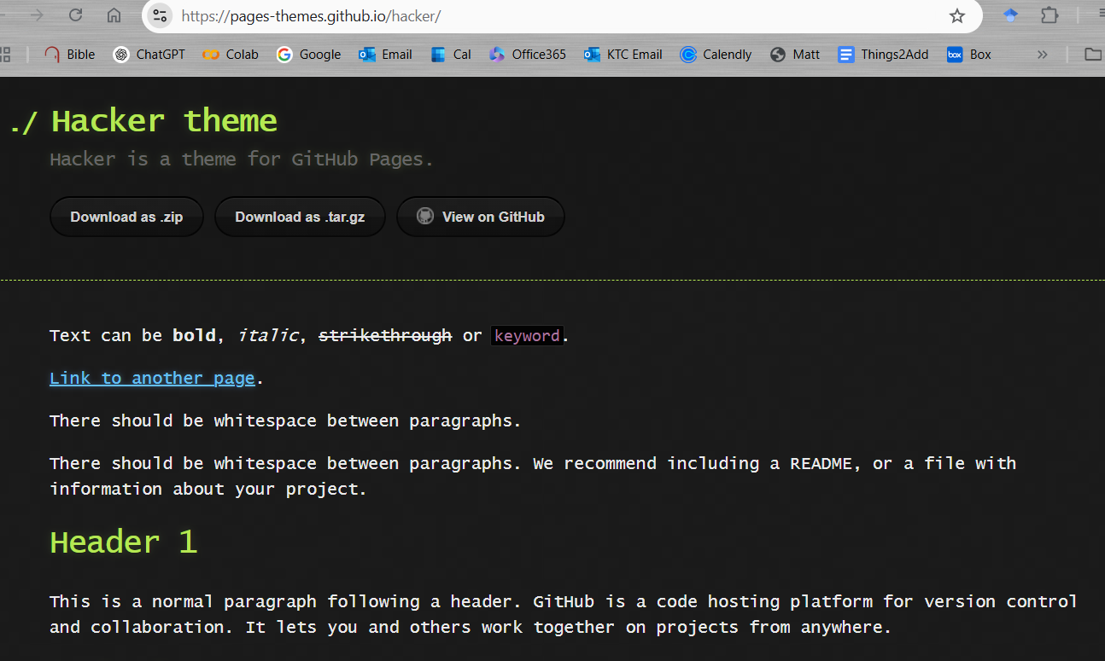
Here are the supported themes
https://pages.github.com/themes/
Architect
Cayman
Dinky
Hacker
Leap day
Merlot
Midnight
Minima
Minimal
Modernist
Slate
Tactile
Time machine

Slide 55




Supported themes continued.
https://pages.github.com/themes/
Architect
Cayman
Dinky
Hacker
Leap day
Merlot
Midnight
Minima
Minimal
Modernist
Slate
Tactile
Time machine

Slide 56



Supported themes continued.
https://pages.github.com/themes/
Architect
Cayman
Dinky
Hacker
Leap day
Merlot
Midnight
Minima
Minimal
Modernist
Slate
Tactile
Time machine

Slide 57


Supported themes continued.
https://pages.github.com/themes/
Architect
Cayman
Dinky
Hacker
Leap day
Merlot
Midnight
Minima
Minimal
Modernist
Slate
Tactile
Time machine

Slide 58
More Themes
Here are some possibly fancier themes you might consider forking
https://jekyllthemes.io/premium
https://github.com/longpdo/neumorphism (example)
https://github.com/academicpages/academicpages.github.io/ https://academicpages.github.io/

Slide 59

Configuring a publishing source for your GitHub Pages site
https://docs.github.com/en/pages/getting-started-with-github-pages/configuring-a-publishing-source-for-your-github-pages-site

Slide 60
Jekyll Installation (optional)
Professor Matthew Lanham
(Former) Academic Director, MS BAIM Program
Associate Director of Student Engagements,
Krenicki Center for Business Analytics & Machine Learning
MatthewALanham.com

Slide 61
Jekyll configuration
Some people use Jekyll (https://jekyllrb.com/docs/) for their GitHub pages site.
Jekyll is a static site generator. It takes text written in your favorite markup language and uses layouts to create a static website. You can tweak the site’s look and feel, URLs, the data displayed on the page, and more.
I did not use Jekyll for my website but some of the previous GitHub pages templates use it so you might find this helpful.
Next, I’ll show you how to install Jekyll so you can explore using it.

Slide 62



Jekyll configuration
Find your OS installation guide here and follow those instructions:
https://jekyllrb.com/docs/installation/
https://rubyinstaller.org/downloads/

Slide 63



Jekyll installation
Follow the instruction steps as shown below.

Slide 64

Jekyll installation
Once installed, you will see the following terminal. Just hit ENTER

Slide 65




Jekyll installation
If you need to get back to the previous terminal, you can find it here in your apps.

Slide 66

Jekyll installation
If you need to get back to the previous terminal, you can find it here in your apps.

Slide 67

To check the versions of your software you can type these commands

Slide 68
Jekyll configuration
Find your OS installation guide here and follow those instructions:
https://jekyllrb.com/docs/installation/
https://jekyllrb.com/docs/configuration/

Slide 69
Additional YouTube Tutorials
Professor Matthew Lanham
(Former) Academic Director, MS BAIM Program
Associate Director of Student Engagements,
Krenicki Center for Business Analytics & Machine Learning
MatthewALanham.com

Slide 70
Some videos you might find helpful
https://youtu.be/CykufIPK_6o?si=eQfiECT443yQ38Hy
https://youtu.be/5XhxR9Vs6zc?si=MhYIUvs_ikcKIvi-
https://youtu.be/g6AJ9qPPoyc?si=FCMrJrOsPqwcQTqB
https://youtu.be/D9CLhQdLp8w?si=9E6f2Eu_49HFqVBd

